Slide 1




New Parent
Information
Night
CAMPBELL
SPARTANS
FENCING

Slide 2

CAMPBELL
for your
SPARTANS
time
FENCING

Slide 3

We plan to cover a lot
of information tonight
and hopefully not overwhelm anyone

Slide 4

But if we do,
please remember...
HELP is just
an email away

Slide 5
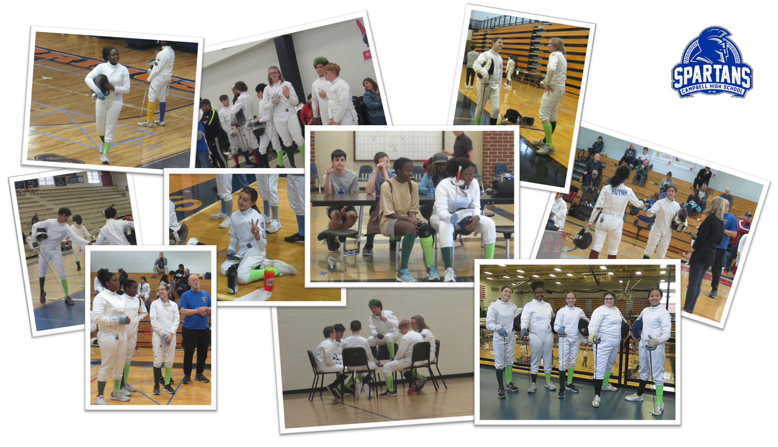

.
1

Slide 6


Our Website:
https://chsfencingcobb.wixsite.com/campbellhs
or Google
Campbell High School Fencing Team

Slide 7
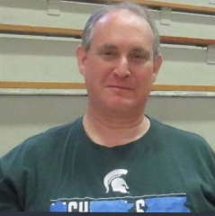
Eric Baskin
Board President
Eric is the father of Julia, a Senior
Previously served as Booster Club Treasurer
Eric also serves as one of the Team’s Armorers

Slide 8
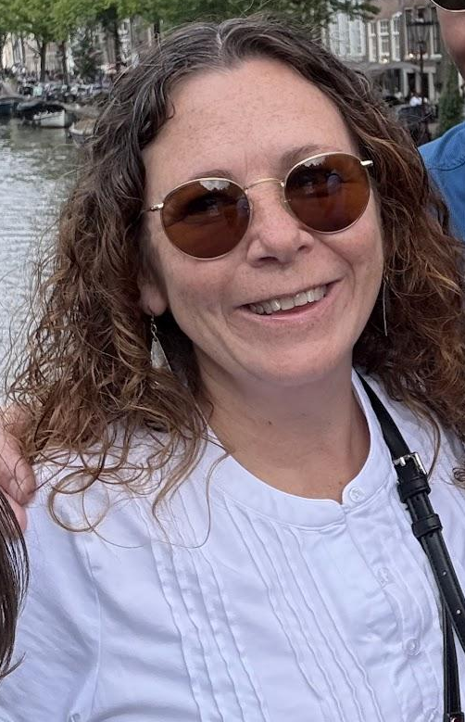
Regina McEwen
Board Vice President
Regina is the mother of Ella, a Junior
Previously served as Board Secretary

Slide 9
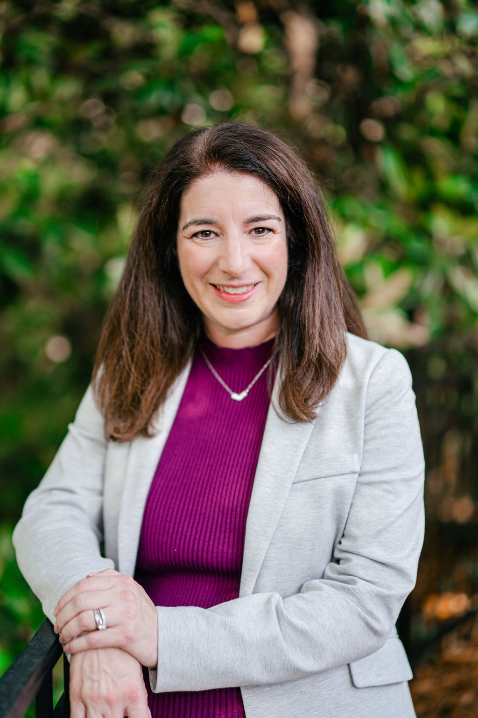
Caryn Kinzler
Board Treasurer
Caryn is the mom of Nathan, a Junior
New board member for 2025-2026

Slide 10
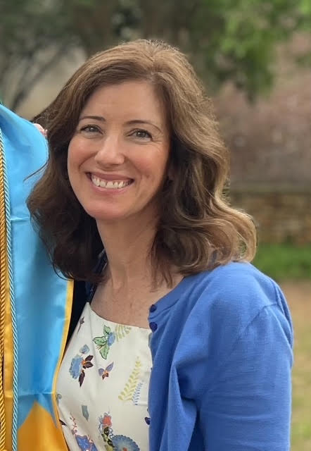
Leighann Buford
Board Secretary
Leighann is the mom of Kinley - a Junior
New board member for 2025-2026

Slide 11
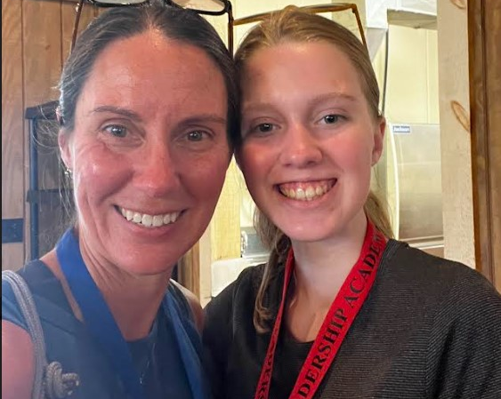
Carmen Hambrick
Board Resource Officer
Carmen is the mom of Addison, a Senior.
Carmen previously served on the board as Co-Vice President

Slide 12
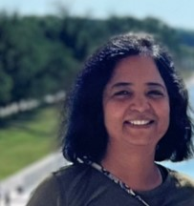
Roopa Patil
Board At-Large Officer
Roopa is the mom of Amulya, a Senior
Roopa previously served as Board Secretary and Vice President

Slide 13
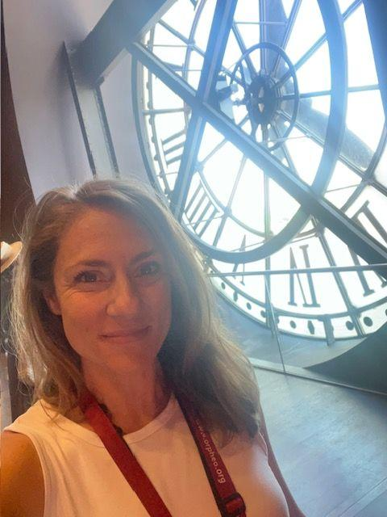
Dr. Heather Lynch
Team Faculty Sponsor
Mother of Gigi, a Junior
She teaches Philosophy

Slide 14
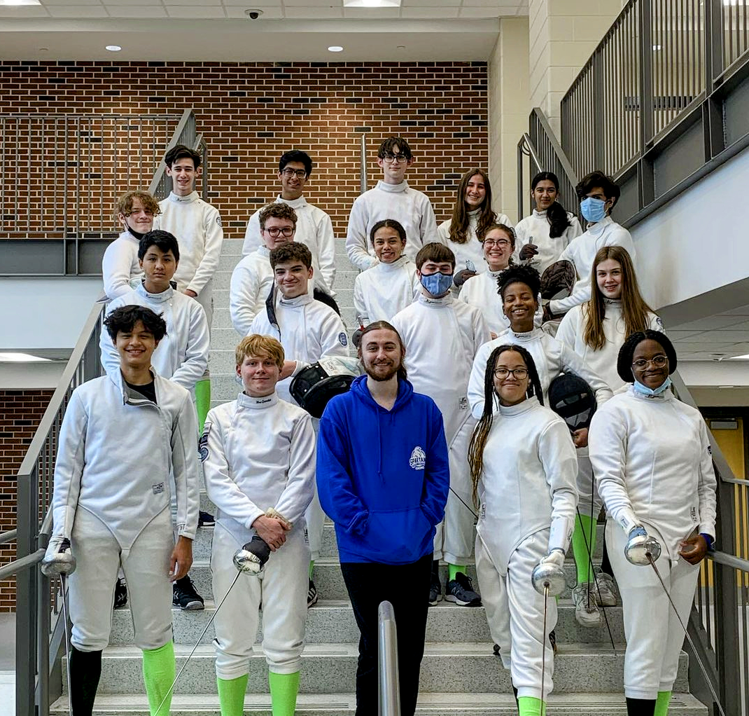
Coach Mason Huffmaster
Mason was a member of the Pope high school fencing team for four years. He ended his high school career at Pope as a team captain. He also actively fenced at Dunwoody Fencing Club from the summer of his freshman year until his second year in college.
He is an assistant coach at Dunwoody Fencing Club​
Coach Mason joined the Campbell Fencing Team in 2020 and has helped our fencers of all experience levels.

Slide 15
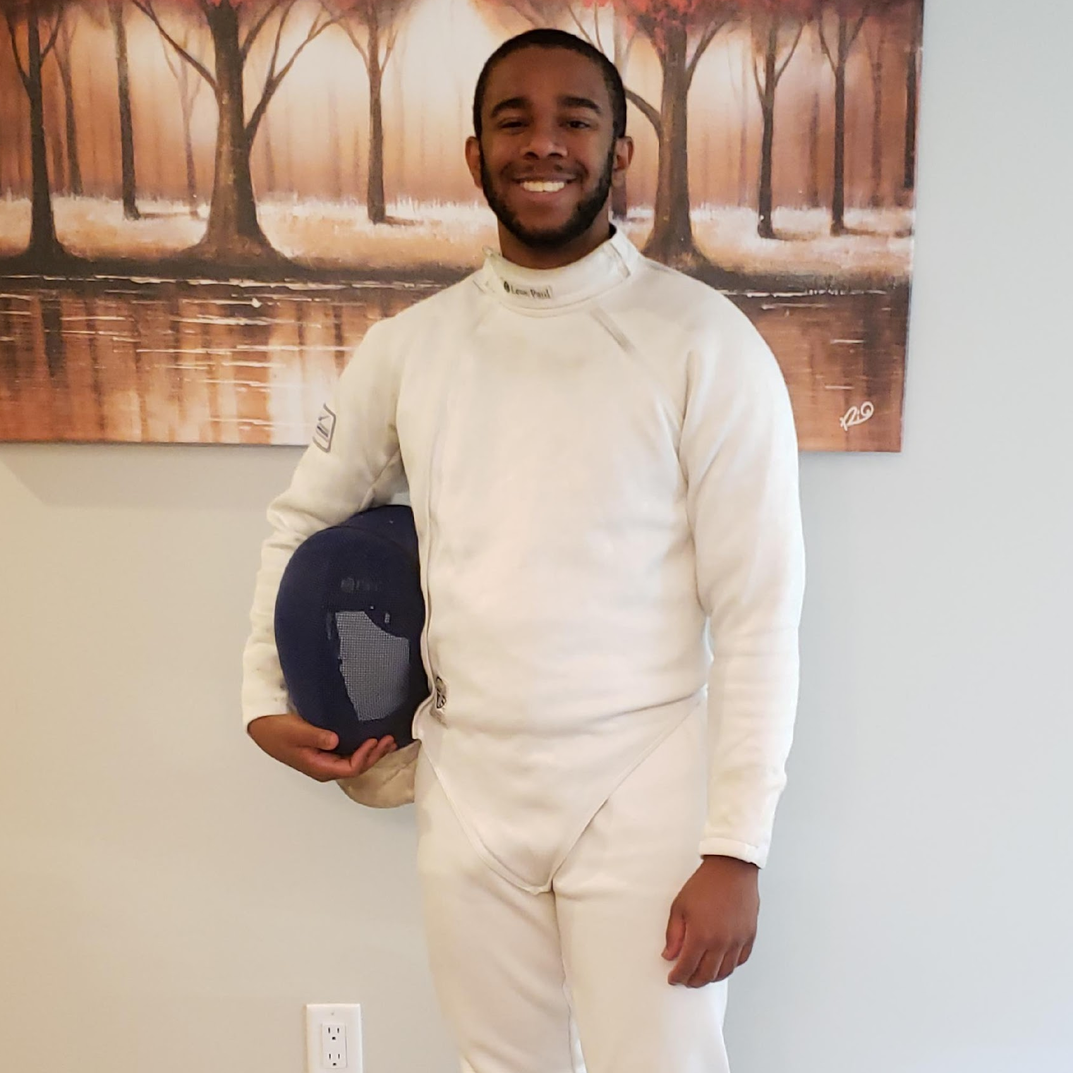
Coach Donovan Munlin
Donovan Munlin began his fencing career at Lassiter High School at the age of fourteen. During his senior year, he became ranked number one on the GHSFL points list and took 5th at Individual Championships.
After graduating, Donovan dedicated all his time to fencing and began coaching straight out of high school. Over the years, Donovan has seen great success both as a coach and competitor.
His teams have always made great progress growing as a unit and enjoying both team and individual successes as a result.
As a competitor, he has been competing nationally for eight years and has even done a few international events as well.
His philosophy as a coach is to use fencing to help his students improve their self-confidence and problem-solving skills.

Slide 16
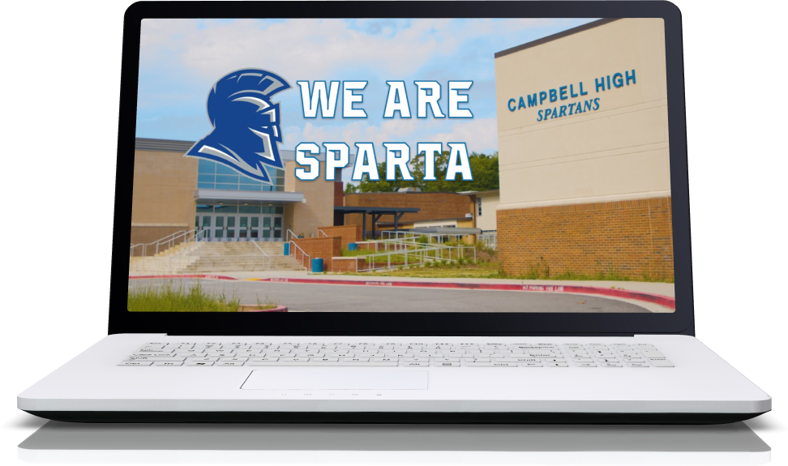
The Goal of Our Club
Is to provide a safe environment that is:
Respectful
Inclusive
Competitive
Supportive
We want our student athletes develop confidence and community while having fun.

Slide 17
ABOUT FENCING
Benefits of Fencing
You are part of a team but you compete 1 vs 1.
Athletes can learn the sport at their own pace.
Fencing promotes mental & physical agility.
One of the safest of all sports.
It’s not too late to learn to fence

Slide 18

ABOUT FENCING
Team Operation and Affiliation
High School Fencing is a club sport in Georgia
We are affiliated with the Georgia High School
Fencing League
We fence against approx. 15-20 High Schools
from the Atlanta Metro area.

Slide 19
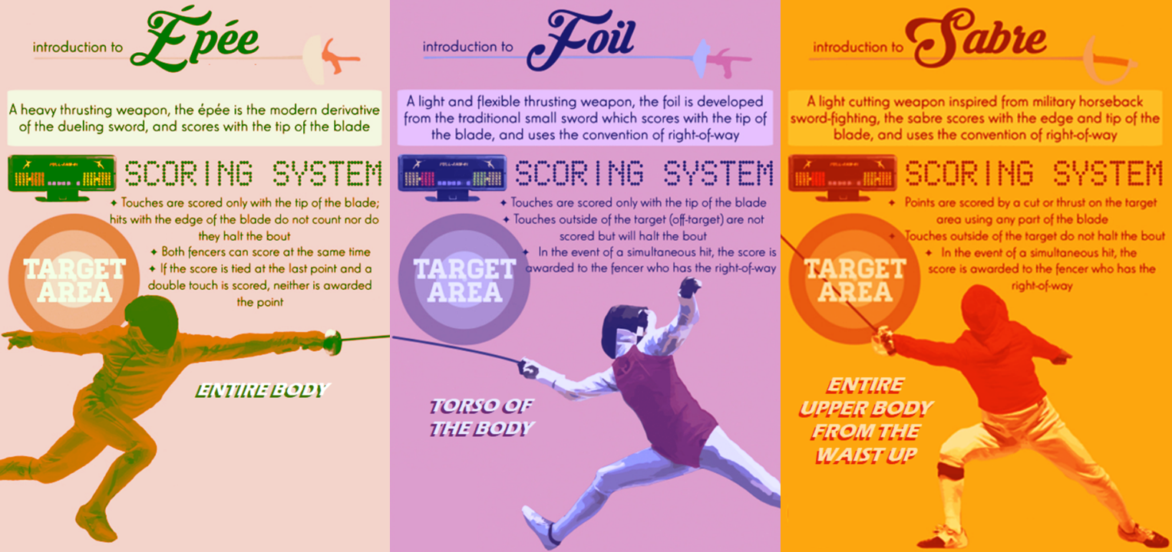


GHSFL teams only fence using the Épée

Slide 20
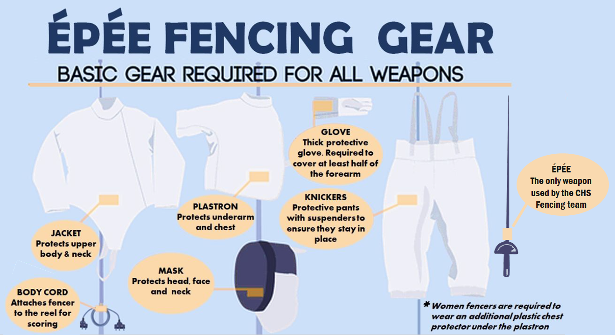

Slide 21
Where Can I Get
Fencing Equipment?
https://www.absolutefencinggear.com
https://www.blue-gauntlet.com
https://vafencinggear.com
  VA will be at practice on 8/27
https://shop.pbtfencing.com
others

Slide 22
Practice
Wednesdays 3:30-6pm in the cafeteria
Fencers are asked to bring plenty of water
to drink to practice.
We welcome water and snack donations
All Fencers must stay until the end of practice and help clean/pack-up
Parents are responsible for pick-up of fencers after practice

Slide 23
Tournaments
A typical fencing season is 6 weekends of tournaments. Each weekend 2 or 3 tournaments are held concurrently. The 15-18 schools in the league are distributed evenly across these 2 or 3 tournaments.
The tournaments may alternate start of men and women. Times for check-in, location, and directions are sent out 1-2 weeks before the tournament
Each high school is responsible for hosting one tournament. All fencers and one family member are required to help setup the day before & the on the day of the home tournament.
Campbell High School will host our home tournament. We need all families involved to volunteer and donate. We welcome family, friends, and community to come cheer on our team.

Slide 24
Lettering
To recognize the individuals competing in High School Fencing and to reward their dedication and achievements, the Campbell High School Fencing Team is approved to award to fencers who meet a set of requirements Campbell High School “Letters.”
Maintain a minimum GPA of 2.5 cumulatively and during each quarter of the season.
Attend at least 80% of practices. Exceptions can be made if a fencer lets a team official know prior to a missed practice with an excused absence from school.
Compete in at least 3 tournaments. This number will be adjusted if there are less than 6 tournaments this year.
Each fencer must volunteer to set up, tear down and participate in teams home tournament.

Slide 25
Volunteering
The Fencing Club is run fully by volunteers
The mighty few cannot do this all by themselves
If you don’t know what to do, we’ll find a job for you
You are the next group of fencers and leadership that will need to keep the team thriving
We need volunteers for every Tournament
We need all families to volunteer for our home tournament
We will send out Sign-up Genius links to sign up for all needs
We need referees!

Slide 26
Requirements
Let’s go through
The New Parent Handout

Slide 27
4. EXPECTATIONS

Slide 28

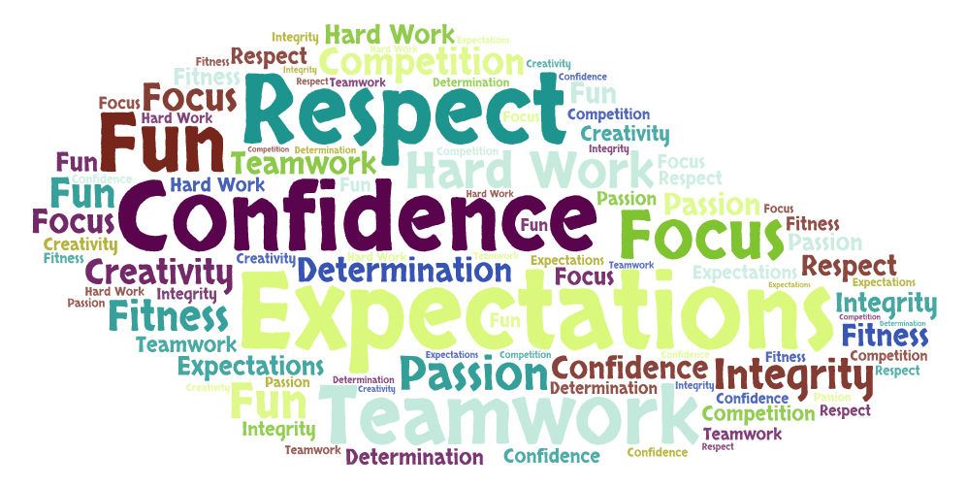

Slide 29
What you can expect from us:
A safe and welcoming environment for all fencers
Open communication with all fencing families
  We will share information about the team and the league as it becomes available
An environment where your fencer will improve & grow in confidence in the sport
  We want to be competitive in the league but not at the expense of the kids having fun
Fair and equal treatment for all fencers
Help with equipment issues that might arise

Slide 30
What we expect from you:
Open communication
  Let us know of any concerns or experience any issues you have
  Sooner is always better than later
Support the club and the application of safety rules
Signup for any of the tournament tasks
  Variety of opportunities throughout the season
Help with setup and cleanup for our home tournament

Slide 31
Overview of the Code of Conduct
No Discrimination
Adhere to Safety Rules
Good Sportsmanship
Maintain Their Equipment
Maintain Self Control at All Times
Respect Others and League Officials
Represent Campbell Positively as Tournaments
No Flash Photography at Tournaments

Slide 32
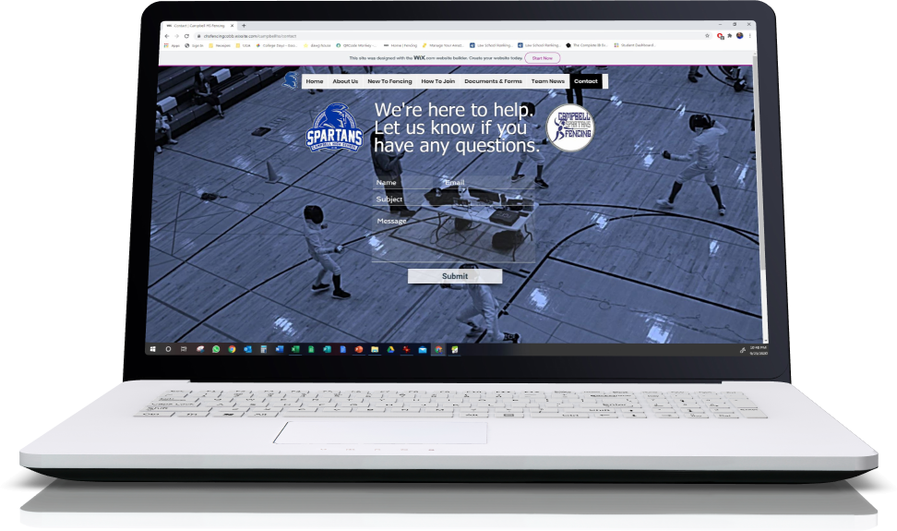
Use Our Website’s Contact Us Page If You Have Any Questions Or Concerns
Google
Campbell High School Fencing Team
Or Find Us @
chsfencingcobb.wixsite.com/campbellhs

Slide 33
